Slide 1

UNIT 5

Slide 2
Grammar: Adverbs Listening: Prices and Money
TABLE OF CONTENT

Slide 3

GRAMMAR

Slide 4
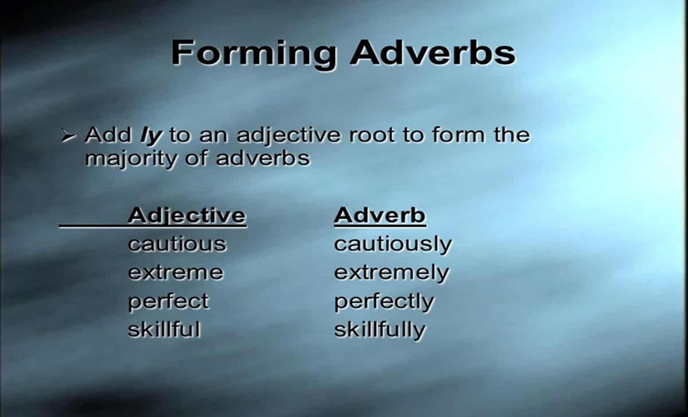
1. Forming an adverb
Look at these examples: 1. They are happy. – They played together happily.
2. You are too loud. - You are speaking loudly.

Slide 5
Note: Not all words ending in –ly are adverbs. Some adjectives end in –ly too, for example: friendly lively elderly lonely silly lovely

Slide 6
Forming adverbs of the following adjectives:
Adjective | Adverb
quick
serious
careful
quiet
heavy
bad
quickly
seriously
carefully
quietly
heavily
badly

Slide 7
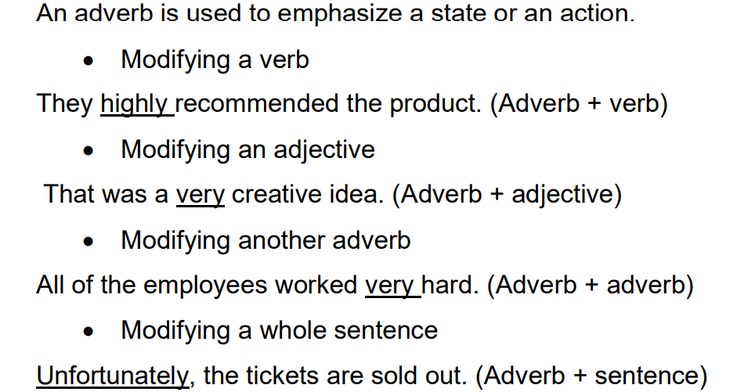
2. Functions of an adverb

Slide 8

Practice: Quizizz games
https://quizizz.com/admin/quiz/5ed64747e3e7b0001b468123
https://quizizz.com/admin/quiz/5f543e7a946249001b8d5ce3

Slide 9
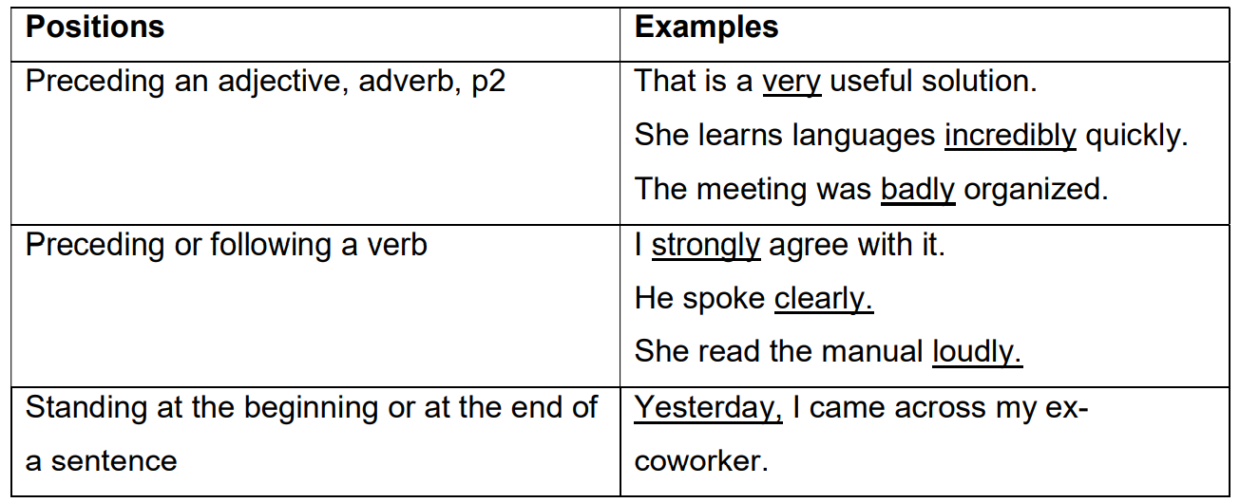
3. Positions of an adverb

Slide 10
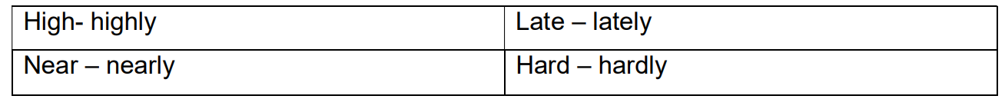
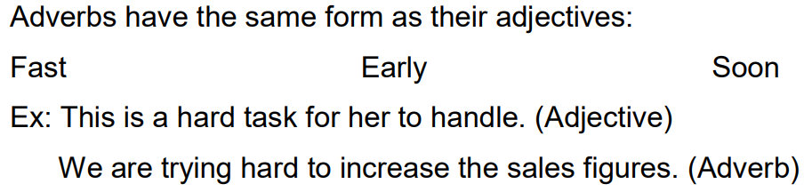
4. Confusing adverbs

Slide 11

Practice
Page 18 - 19

Slide 12
Exercise A: Choose the correct option in brackets for each sentence.
1. The sales clerk (high / highly) recommended this item.
2. The copy machine is (currently / current) out of order.
3. (Unfortunately / Unfortunate), he is not available now.
4. The computer was not working (properly / proper).
5. The R&D team (successfully / successful) completed the project.
6. When it rains, you should drive (careful / carefully).
7. He’s always in a rush. I don’t understand why he walks so _________ (quick/quickly).
8. I prefer studying in the library. It’s always_______________ (quiet/quietly).
9. Michael __________ (happy/happily) took the assistant job. He had been looking for a position all summer.
10. Marta dances _____________ (beautiful/beautifully). She’s been taking ballet since she was five years old.

Slide 13
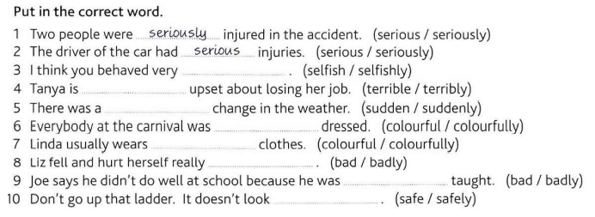
Exercise B.
selfishly
terribly
sudden
colourfully
colourful
badly
badly
safe

Slide 14
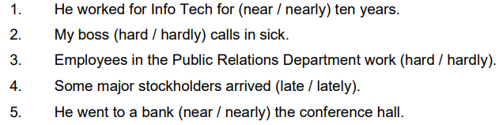
Exercise C. Choose the correct option in brackets for each sentence.

Slide 15
Exercise D. Choose the correct option to complete each sentence.
Car prices have decreased ____ due to low demand
A last B lateness C lately D late
2. My coworker ____ comes in late. He is always on time.
A never B always C usually D sometimes
3. The new policy was ___ difficult to implement
A extreme B extremes C extremely D to extreme
4. The vice president ____ retired as of last Monday.
A office B official C officially D offices

Slide 16
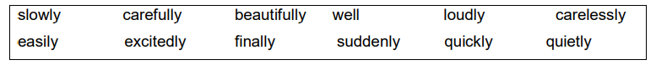
Exercise E. Complete the sentences with the best adverb. Not every adverb is needed.
Come here ____________. You have to see this!
2. We knew that she had got the job when we saw her _________ talking on the phone.
3. He ______________ put the vase on the table. It fell to the floor.
4. Sharon is throwing a party on Saturday. She ___________ finished her PhD.
5. Let’s walk ________________. I don’t want to be the first one at the meeting.
quickly
excitedly
carelessly
finally
slowly

Slide 17
6. Alex _____________ put up the bookshelves. It was too difficult for me to do on my own.
7. Every thing happened so ______________. We had to move to California in less than a month.
8. Why does he always have to talk so ____________. You can hear him in the next room!
9. Although she speaks five languages, she did not do ___________ on the translation exam.
10. I was so surprised. His new apartment was _____________ decorated.
carefully
suddenly
loudly
well
beautifully

Slide 18
:
LISTENING:
Unit 3: PRICES AND MONEY

Slide 19
LISTENING:

Slide 20

Currency symbols:

Slide 21
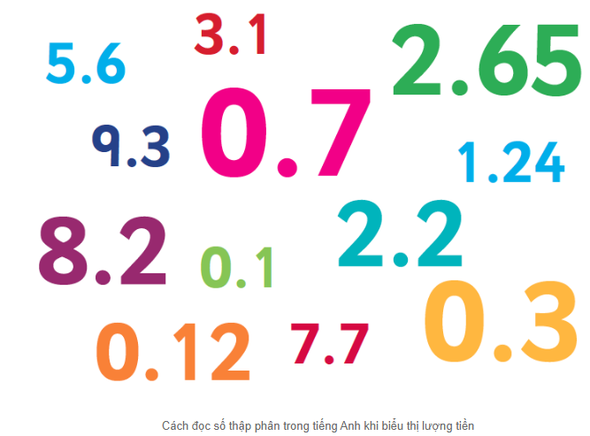
Cách đọc số thập phân trong tiếng Anh khi biểu thị lượng tiền
Lượng tiền hay giá tiền trong tiếng Anh (Dollar và Cent hoặc Pound và Pence)
sẽ có cách đọc khác với cách đọc số thập phân trong tiếng Anh ở trên.

Slide 22
Cách đọc:
Đọc phần nguyên + dollar/euro/pound + đọc phần thập phân như số đếm (+ cent/pence)
100 cents = 1 dollar (đô-la)
100 cents = 1 euro (đồng Euro)
100 pences = 1 pound (bảng Anh)
Ví dụ:
$19.91 = nineteen dollars, ninety-one (cents)
$0,5 = fifty cents
£1.60 = one pound sixty (pences)
€250.05 = two hundred and fifty euros, five (cents)

Slide 23

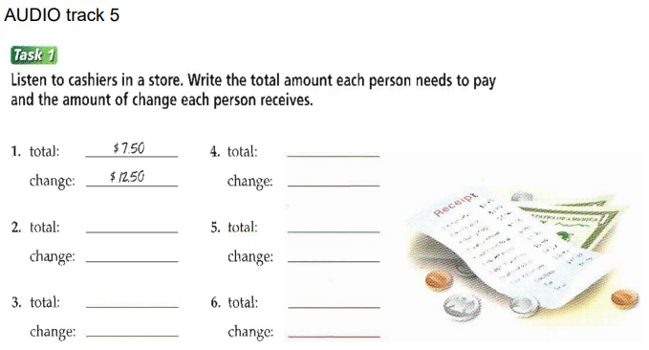

Slide 24
Track 5
1. So that comes to $7.50 and your change is $12.50.
2. That comes to $19.90. So here’s your change, ten cents.
3. Yes, so that’s, let me see, $9.65, right? Here’s your change, $10.35.
4. so that’s $8.15, and here’s your change, $11.85.
5. So that’s $12.49. And here’s your change, $7.51.
6. So that comes to $18.25 altogether. And here’s your change. That’s a dollar seventy-five.

Slide 25
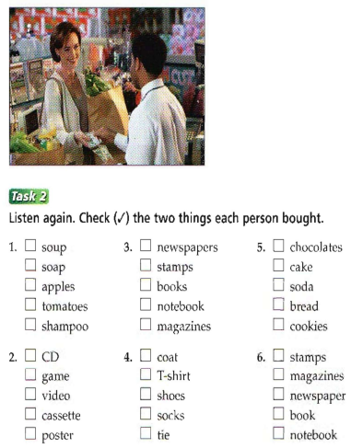

Track 5
1.
Let’s see. Soup. That’s two for a dollar. And a bottle of shampoo—$6.50. So that comes to $7.50 and your change is $12.50.
2.
Okay, now—let me see what you’ve got. The CD is $14.95, and the cassette—oh, a good one, my favorite group—it’s on sale for $4.95. So, let me see…. That comes to $19.90. So here’s your change, ten cents.

Slide 26

Track 5
3. Yes, can I help you? Okay. Let’s see. The newspapers are $1.50, and the magazines will cost another…$8.15. Yes, so that’s, let me see, $9.65, right? Here’s your change, $10.35.
4. So you’re taking the T-shirt—nice choice. The color suits you. Okay, that’s $4.95, then the socks. They’re another $3.20, so that’s $8.15, and here’s your change, $11.85.

Slide 27
Track 5
5. Mmm, I like chocolates, too. Okay, that’s $9.50 for the chocolates. And chocolate chip cookies, too. Mmm. You really do like chocolate. The cookies are $2.99. So that’s $12.49. And here’s your change, $7.51.
6. Is this all? Okay. Let’s see. Now the magazines are $6.25. And you’re taking the book? That’s $12.00. So that comes to $18.25 altogether. And here’s your change. That’s a dollar seventy-five.

Slide 28
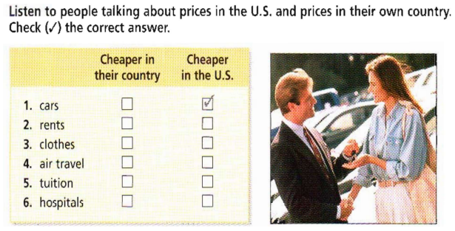

Slide 29
Track 6
1. I could never buy a car at home because we pay a very high tax on cars. Only rich people can really afford to buy a car at home. Here in the U.S., I drive a nice new car and I can easily afford it. You don’t have to be rich to own a car, which is great.
2. At home it only costs about $200 a month to rent a nice apartment. That’s what I used to pay for a four-room apartment in a good neighborhood. Here in the U.S., I pay about twice that for a much smaller apartment, and it’s not in a very nice neighborhood. 3. I bought a lot of clothes in my country before I moved to the U.S. because everyone told me how expensive American clothing is. I was kind of surprised that I could get nice clothes here for very reasonable prices. In fact, it costs me less for clothes here than it used to cost me at home. 4. I come from a small country and not a lot of people travel by plane because it costs more than most people can afford. But the U.S. is such a big country and the population is large, so you have a lot of people traveling by plane. That’s what keeps the prices down. That means I can afford to fly here and I do it all the time. I couldn’t do that at home. 5. Most people send their children to private schools at home because the public schools are not very good. You have to pay a lot to do that, so it’s a big expense for many people. Public schools are better here, and cheaper than in my country. People don’t have to spend a lot on tuition, so most people send their children to public schools. 6. Here in the U.S. you need to have health insurance because it costs a lot to see a doctor or to enter a hospital. At home, you don’t have to pay much to see a doctor or go to a hospital because most of the clinics and hospitals are run by the government.

